Slide 1
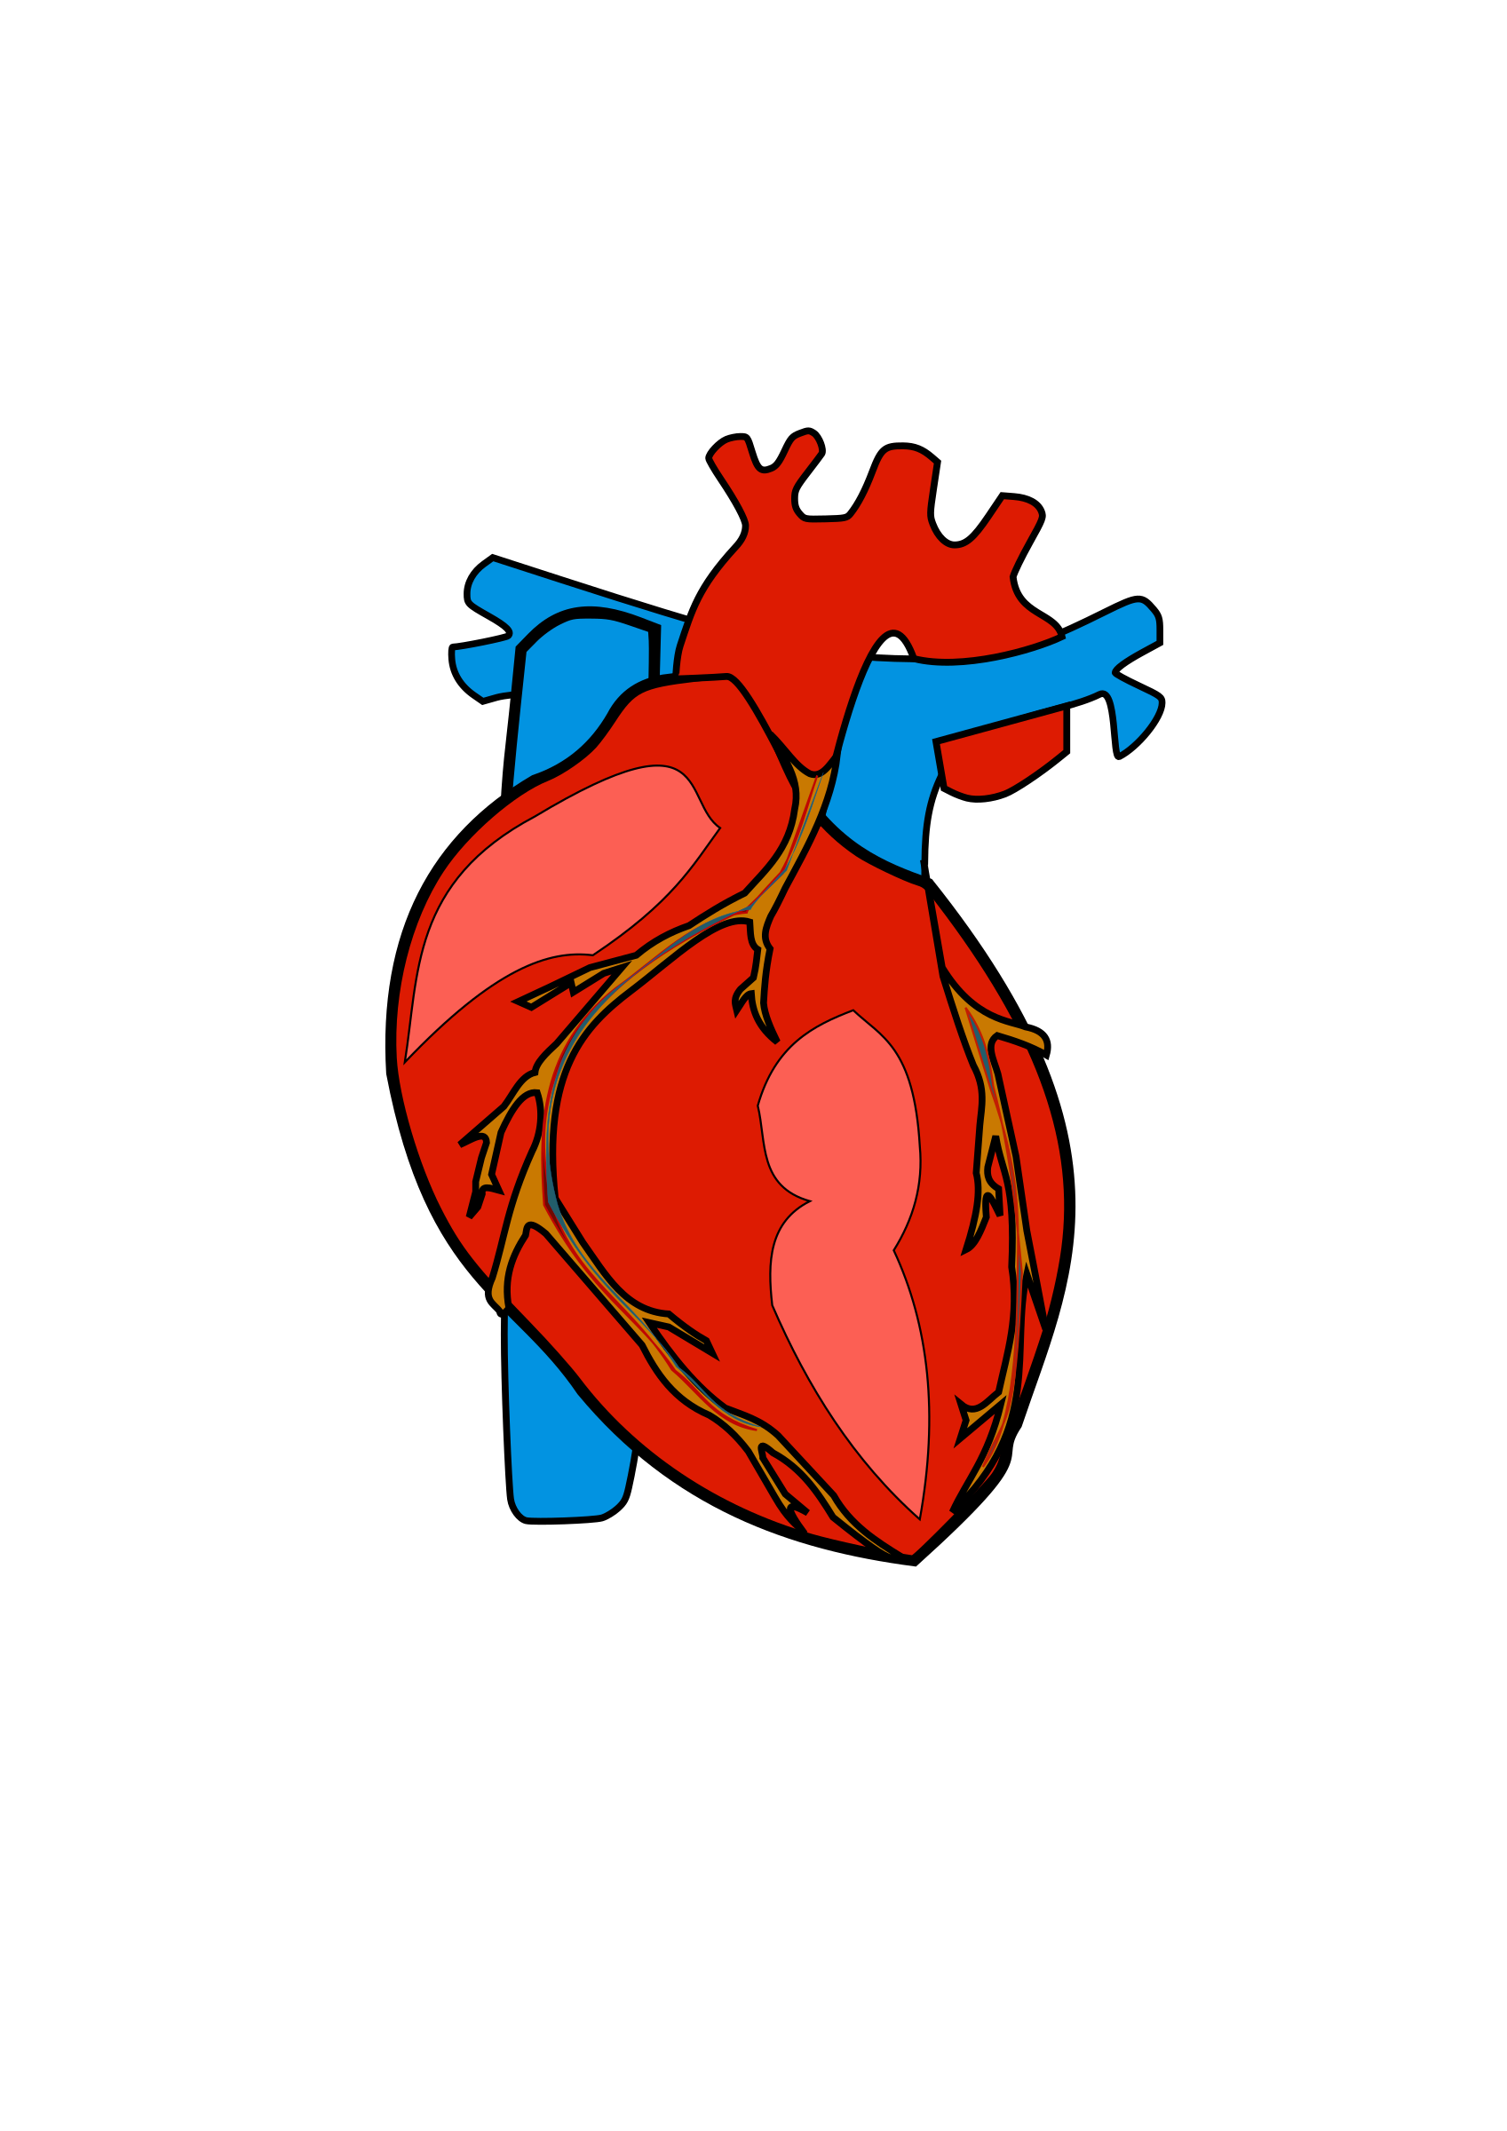

Python Final Project: Heart Disease
Group 6: Alexander Baker, Sanyukta Baluni, Sohini Chakraborty, Nitin Jayan, Dae Sung Kim.
M.S. BAIM program course: MGMT-58600 Python Programming
Presented: August 2nd, 2022

Slide 2

Introduction: The Dataset
The BRFSS 2020 Survey Data is our dataset. (Behavioral Risk Factor Surveillance System.)
The study is conducted by the federal bureau of the CDC (Center for Disease Control,) in collaboration with the local state and territory governments in the United States.
The raw dataset had a total of 279 variables, which were condensed into only relevant 19 variables.

Slide 3
Introduction: Selected Variables
_STATE – U.S. State name?
SEXVAR – Are you male or female?
PHYSHLTH – Days with poor physical healthy?
MENTNHLTH – Days with poor mental health?
HLTHPLN1 – Have any health care coverage?
EXERANY2 – Exercise in Past 30 Days?
SLEPTIM1 – How many hours of sleep in a 24-hour period?
DRNK3GE5 – Binge Drinking?
CNCRDIFF – How many different types of cancer have you had?
MICHD – (Ever told) you had a heart attack, or heart disease?
CVDSTRK3 – Ever Diagnosed with a Stroke?
DIABETE4 – (Ever told) you had diabetes?
VETERAN3 – Are You A Veteran?
INCOME2 – Income Level?
SMOKE100 – Smoked at Least 100 Cigarettes?
CNCRTYP1 – What type of cancer was it?
_IMPRACE – Imputed race/ethnicity value?
_BMI5 – Body Mass Index (BMI)?
_BMI5CAT – Body Mass Index (BMI) category?

Slide 4
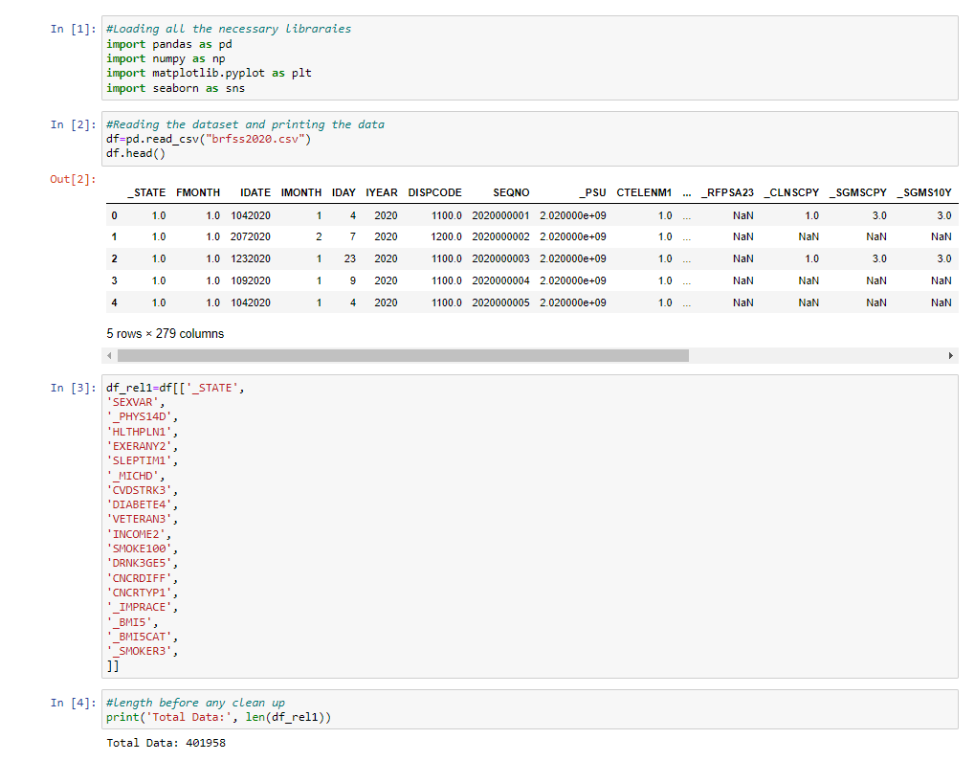
Introduction: The Script
Example of python code, file: “Python Final Project v6.ipynb”

Slide 5
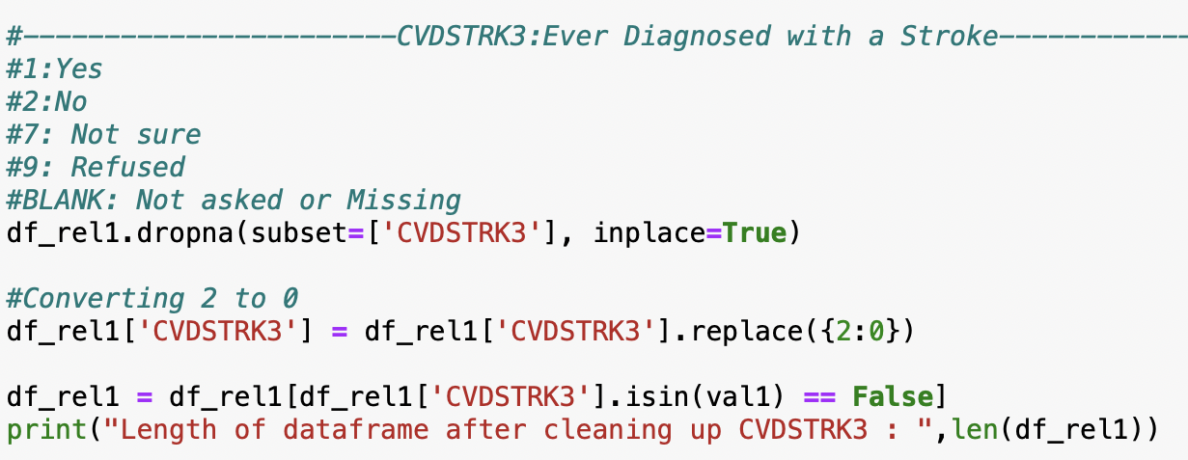
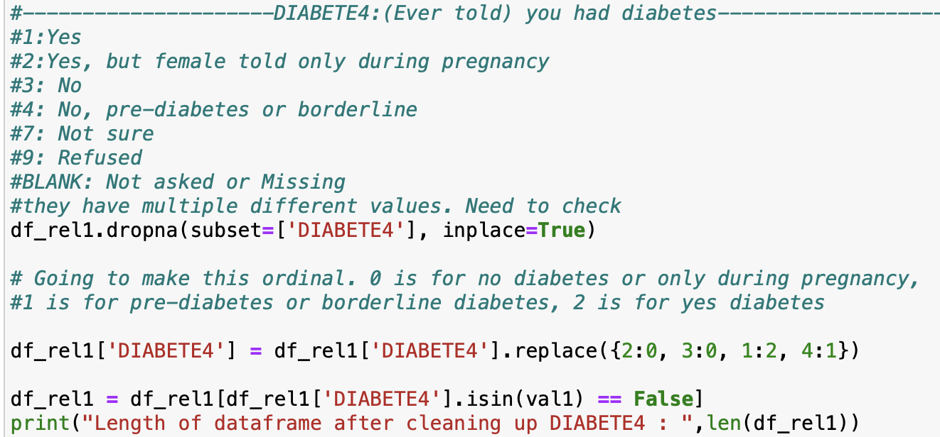
Data Cleaning: The Procedure

Slide 6
Data Cleaning: Edits
Keep only variables of interest, i.e. SEXVAR – Are you male or female, EXERANY2 – Exercise in Past 30 Days, etc.
Drop any blanks, ‘not sure’, ‘refused’ values
Make the values ordinal, i.e. 0, 1, 2, etc.

Slide 7
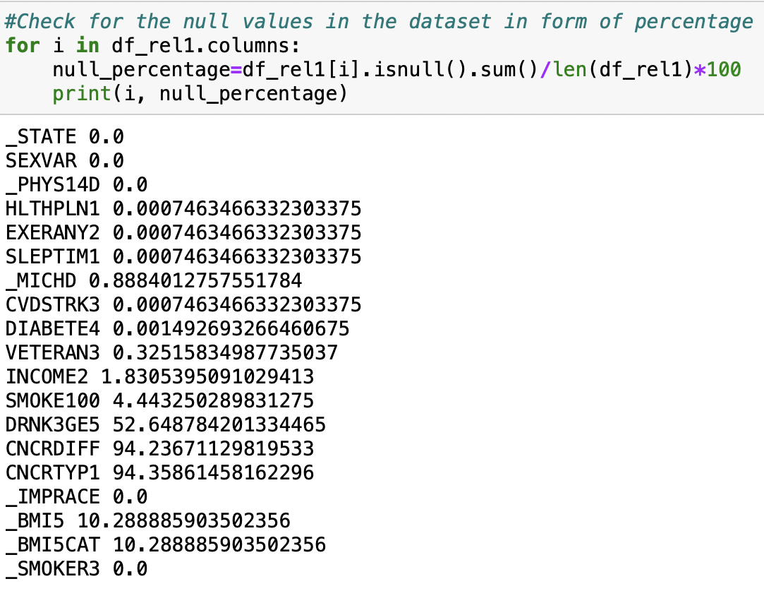
Data Cleaning: Null Percentage

Slide 8


Slide 9
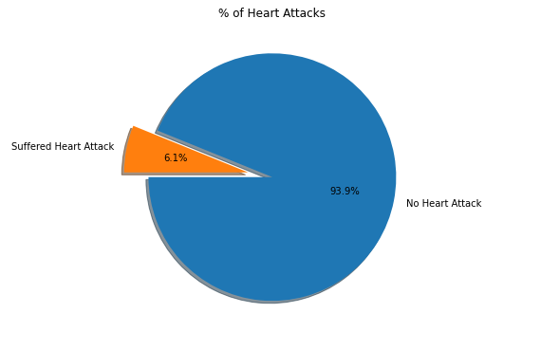
Analysis: Heart Attacks
Heart attack rate in U.S. population.
How many people have ever suffered a heart attack?
Excludes those who suffered from a fatal heart attack.

Slide 10
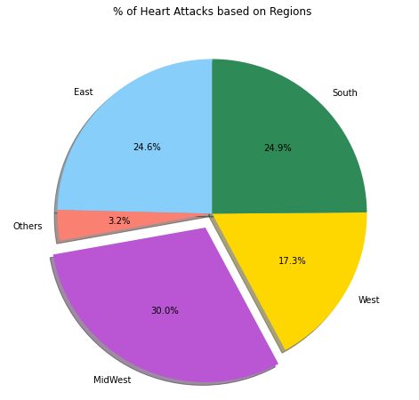
Analysis: Limitations
Heart attacks based on region, does not address regional population.
Does not address demographic confounding variables unique to those regions.
For these reasons, itdoes not provide potential evidence for the causes of myocardial infarction.

Slide 11
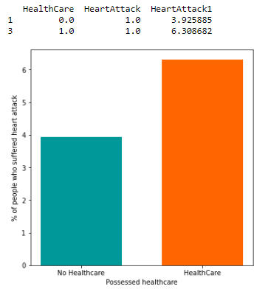

Analysis: Healthcare
Healthcare access and heart attack, people with healthcare suffers from more heart attacks.
Younger people tend not to have healthcare compared to older people, especially those with heart disease.

Slide 12
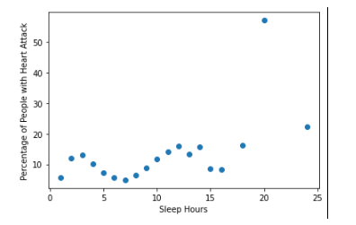
Analysis: Sleep
Data does demonstrate a weak correlation between sleep and heart disease.
There are two peaks ~3 and ~13 hours, where heart disease is elevated.

Slide 13
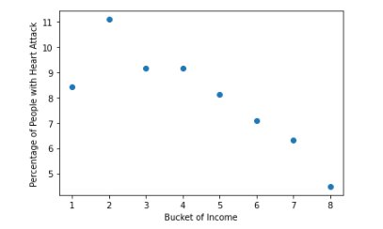
Analysis: Income
Higher income is associated with lower heart disease risk.

Slide 14
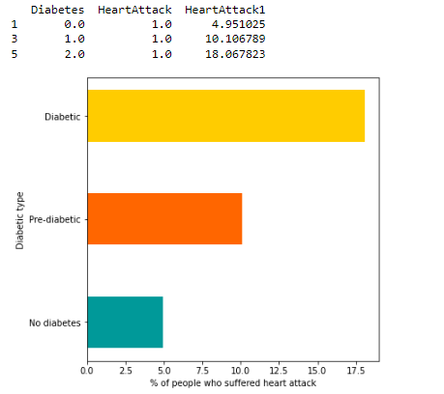

Analysis: Diabetes

Slide 15
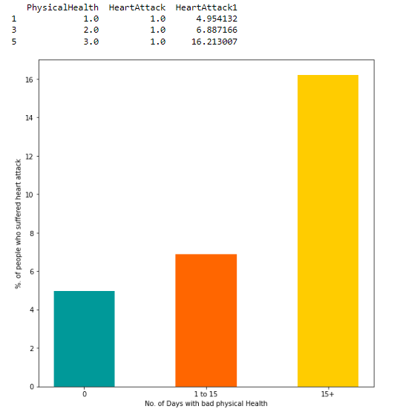

Analysis: Bad Physical Health

Slide 16
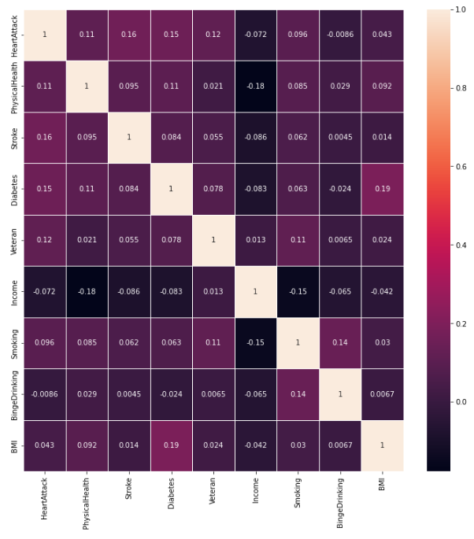
Analysis: Correlated Variables
Heat map of variables analyzed.

Slide 17
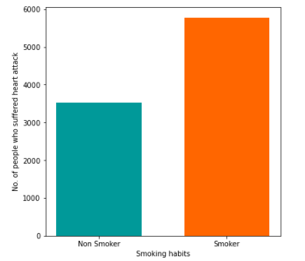

Analysis: Smoking
Smoking is correlated with heart disease. It is a proven risk factor causing myocardial infarction.

Slide 18
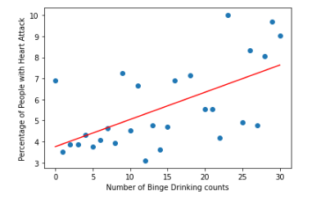
Analysis: Binge Drinking
Binge drinking is correlated with heart disease.

Slide 19
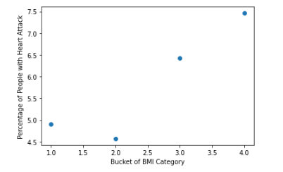
Analysis: BMI and Heart Disease
Heart disease increases linearly with BMI.

Slide 20
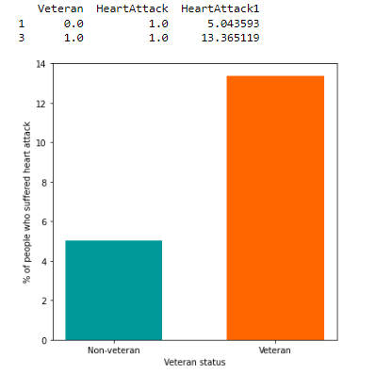
Analysis: Veterans
Veterans suffer from more heart disease than nonveterans. Likely because most veterans are men.

Slide 21
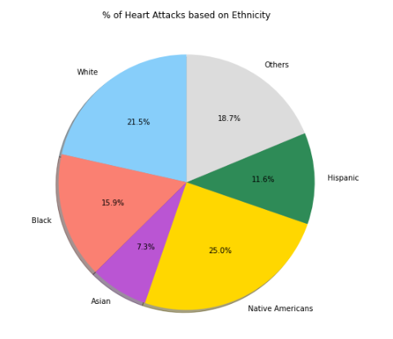
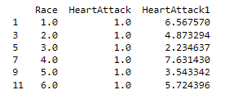
Analysis: Ethnicity

Slide 22
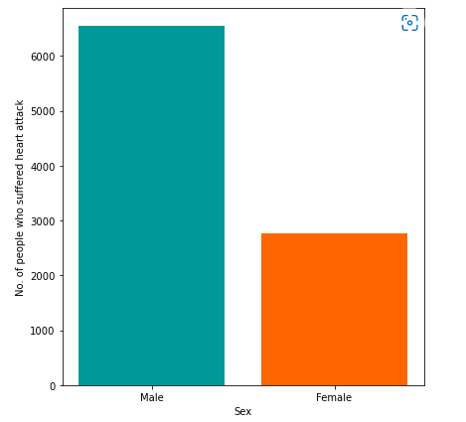
Analysis: Gender
Men suffer more from heart disease.

Slide 23
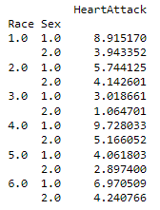
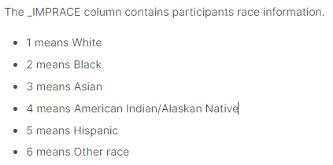
Analysis: Race and Sex Combined
Heart attacks by race and sex, men are more likely to suffer from heart disease. Native Americans are mostly likely to suffer from heart disease, and Asians are the least.

Slide 24
Concluding Thoughts: What we Learned
Myocardial infarction, also known as heart disease is the leading cause of death in America. In 2020 alone 697,000 people died of heart disease. (Heart Disease Facts.)
Certain behaviors and characteristics are associated with an elevated risk factor for heart disease. Some can be controlled, such as smoking, drinking, being overweight, etc.
Statistics allow us to identify these risk factors, and advise the public on safe life decisions to minimize their risk for cardiovascular disease.

Slide 25
Citation for Dataset:
BRFSS 2020 Survey Data. (2022, January 4). [The Behavioral Risk Factor Surveillance System (BRFSS) is a collaborative project between all of the states in the United States and participating US territories and the Centers for Disease Control and Prevention.]. Ahmet Emre. https://www.kaggle.com/datasets/ae mreusta/brfss-2020-survey-data
Heart Disease Facts | cdc.gov. (2022, July 15). Centers for Disease Control and Prevention. https://www.cdc.gov/heartdisease/facts.htm

